Slide 1

Algebra 1
Unit 7, Lesson 6 Factoring by Grouping Volume 1, pg. 386

Slide 2


Benchmark
MA.912.AR.1.7
Rewrite a polynomial expression as a product of polynomials over the real number system.
volume 1, pg. 386

Slide 3
Integrated Mathematical Thinking and Reasoning Standards
MA.K12.MTR.3.1 Complete tasks with mathematical fluency.
MA.K12.MTR.4.1 Engage in discussions that reflect on the mathematical thinking of self and others.
MA.K12.MTR.5.1 Use patterns and structure to help understand and connect mathematical concepts.
volume 1, pg. 386

Slide 4

Learning Target
I can factor a polynomial by grouping.
volume 1, pg. 386

Slide 5

Warm-Up
volume 1, pg. 387

Slide 6
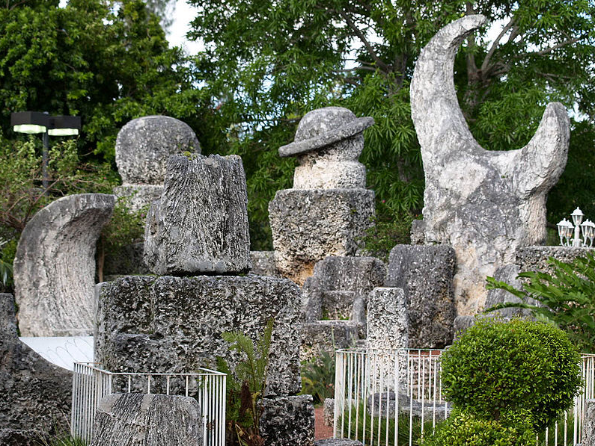
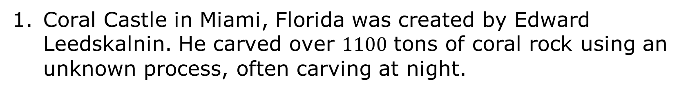
7.6.1 Warm-Up: Notice and Wonder
Coral Castle in Miami, Florida was created by Edward Leedskalnin. He carved over $1100$ tons of coral rock using an unknown process, often carving at night.
volume 1, pg. 387

Slide 7
What do you notice about the sculptures?
What do you wonder about the process Ed used?
volume 1, pg. 387

Slide 8

Guided Instruction
volume 1, pg. 387

Slide 9
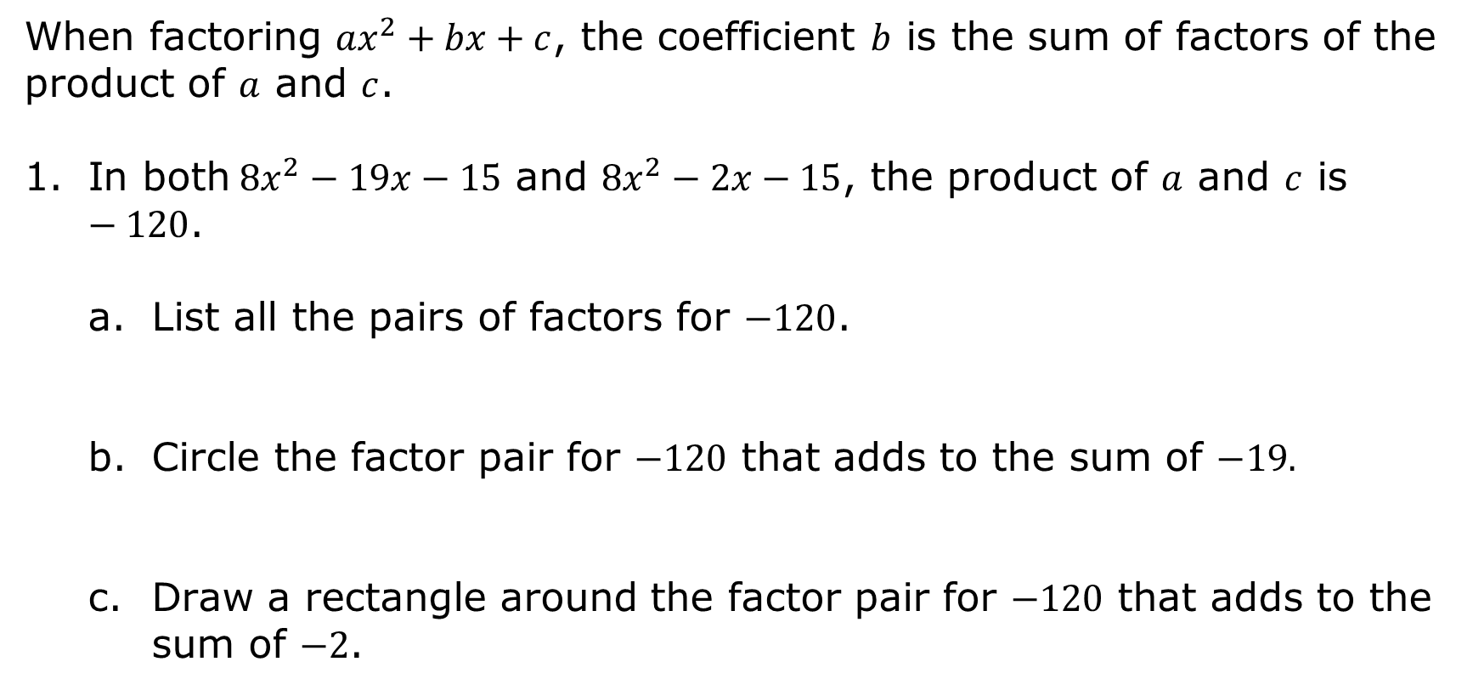
7.6.2 Guided Instruction: Factoring by Grouping
When factoring ${ax}^{2}+bx+c$, the coefficient $b$ is the sum of factors of the product of $a$ and $c$.
In both$8x^{2}−19x−15$ and $8x^{2}−2x−15$, the product of $a$ and $c$ is $−120$.
List all the pairs of factors for $−120$.
Circle the factor pair for $−120$ that adds to the sum of $−19.$
Draw a rectangle around the factor pair for $−120$ that adds to the sum of $−2$.
volume 1, pg. 387

Slide 10
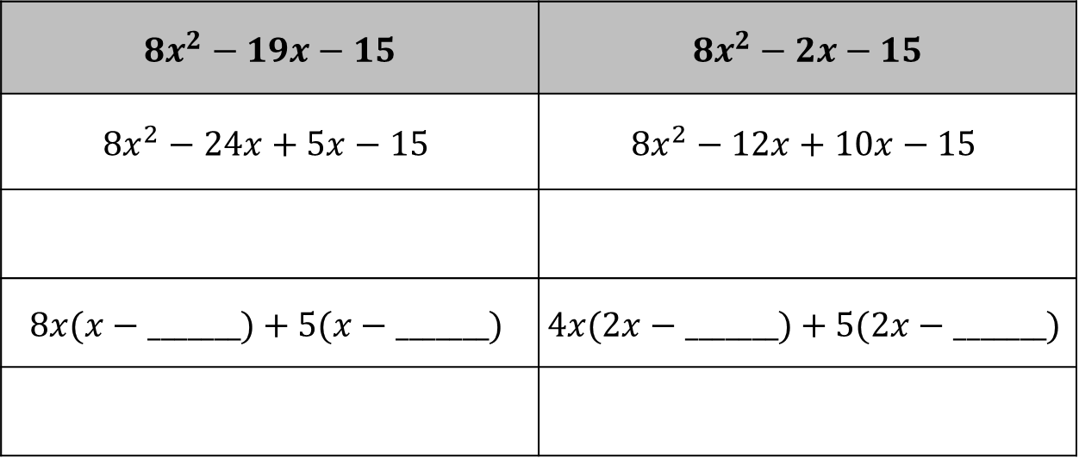
The factor pairs can be used to factor by grouping. Complete the steps for factoring by grouping for each trinomial.
$$8x^{2}−19x−15$$ | $$8x^{2}−2x−15$$
$$8x^{2}−24x+5x−15$$ | $$8x^{2}−12x+10x−15$$
$$8x(x−_______)+5(x−_______)$$ | $$4x(2x−_______)+5(2x−_______)$$
volume 1, pg. 388

Slide 11
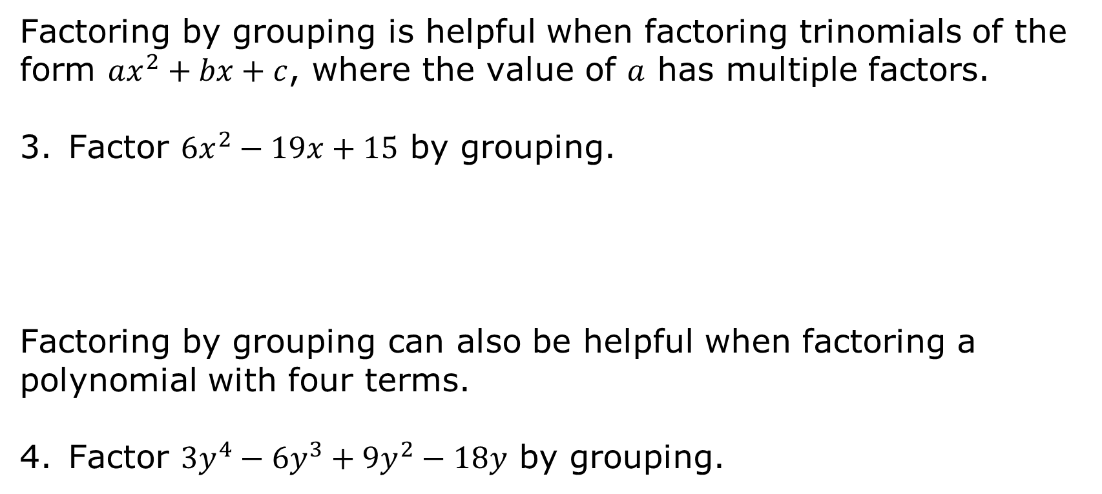
Factoring by grouping is helpful when factoring trinomials of the form $ax^{2}+bx+c$, where the value of $a$ has multiple factors.
Factor ${6x}^{2}−19x+15$ by grouping.
Factoring by grouping can also be helpful when factoring a polynomial with four terms.
Factor $3y^{4}−6y^{3}+9y^{2}−18y$ by grouping.
volume 1, pg. 388

Slide 12
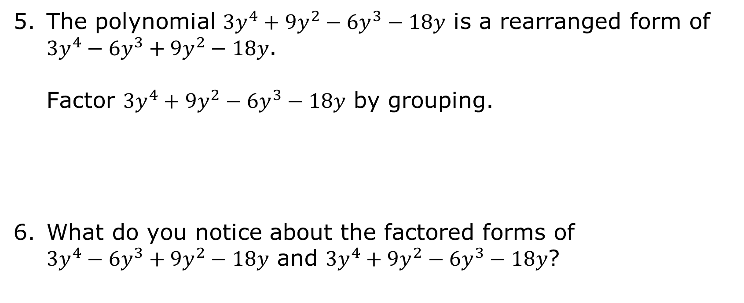
The polynomial $3y^{4}+9y^{2}−6y^{3}−18y$ is a rearranged form of $3y^{4}−6y^{3}+9y^{2}−18y$.
Factor $3y^{4}+9y^{2}−6y^{3}−18y$ by grouping.
What do you notice about the factored forms of $3y^{4}−6y^{3}+9y^{2}−18y$ and $3y^{4}+9y^{2}−6y^{3}−18y$?
volume 1, pg. 388

Slide 13

Guided Practice
volume 1, pg. 389

Slide 14

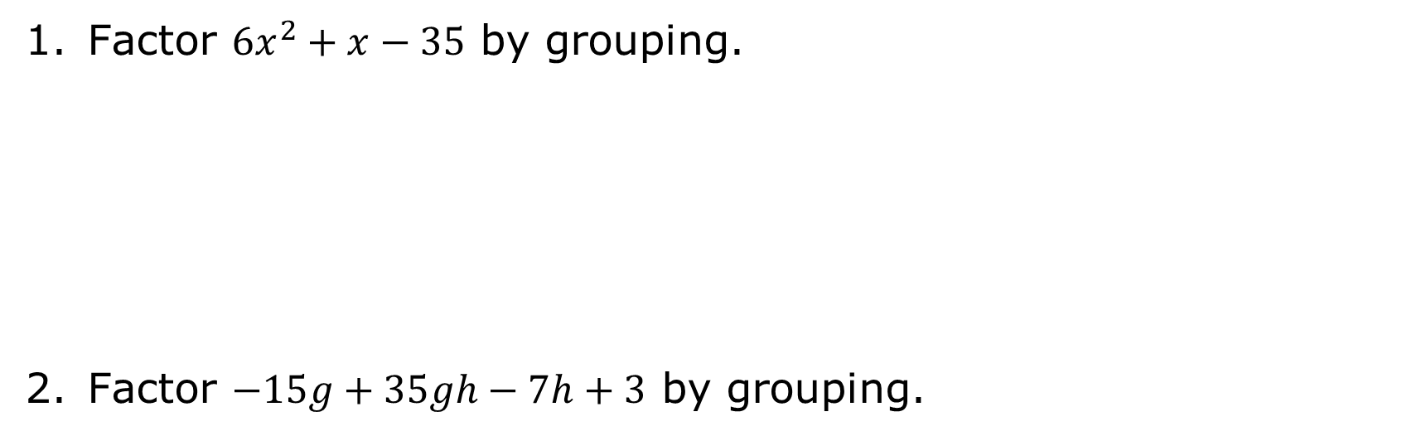
7.6.3 Guided Practice: Factoring by Grouping
Factor ${6x}^{2}+x−35$ by grouping.
Factor $−15g+35gh−7h+3$ by grouping.
volume 1, pg. 389

Slide 15

Collaboration
volume 1, pg. 389

Slide 16

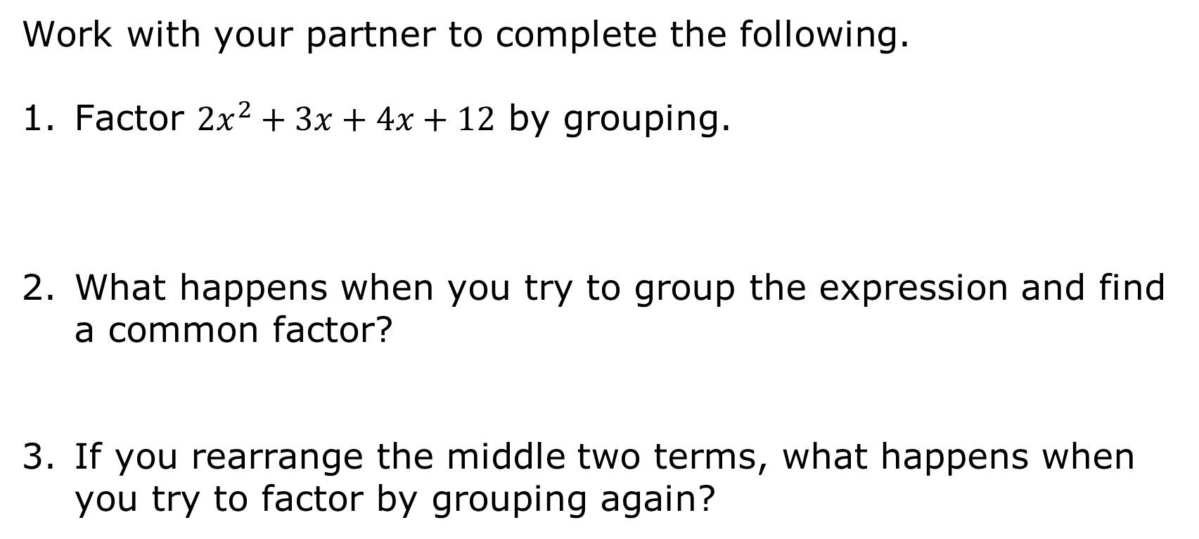
7.6.4 Collaboration: Factoring by Grouping
Work with your partner to complete the following.
Factor ${2x}^{2}+3x+4x+12$ by grouping.
What happens when you try to group the expression and find a common factor?
If you rearrange the middle two terms, what happens when you try to factor by grouping again?
volume 1, pg. 389

Slide 17
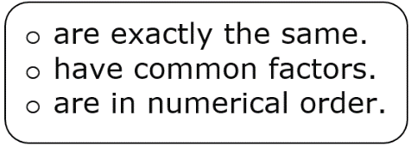
Complete the statement.
When factoring an expression by grouping, group terms that have coefficients that
Work with your partner to create a strategy for the best way to group an expression.
volume 1, pg. 389

Slide 18

Your Turn
volume 1, pg. 390

Slide 19
7.6.5 Your Turn!
Factor ${12x}^{2}−16x−3$ by grouping.
volume 1, pg. 390

Slide 20

Wrap-Up
volume 1, pg. 390

Slide 21

7.6.6 Wrap-Up: Ticket Out the Door
Factor each expression.
$h^{2}−12h+27$
$36a^{4}b^{7}+42a^{6}b^{3}$
${12x}^{2}−8x−15$
${5x}^{2}+37x+14$
volume 1, pg. 390

